Slide 1
Incidence Matrices

Slide 2
The following incidence matrices are of interest in power network analysis
Element-node incidence matrix
Bus incidence matrix
Branch path incidence matrix
Basic cut-set incidence matrix
Basic loop incidence matrix

Slide 3
Element-node incidence matrix
Element node incidence matrix A shows the incidence of elements to nodes in the connected graph. The incidence or connectivity is indicated by the operator as follows:
a = 1 if the p^{th} element is incident to and directed away from the q the node.
a = -I if the p^{th} element is incident to and directed towards the q the node.
a = 0 if the p^{th} element is not incident to the q^{th} node.
The element-node incidence matrix will have the dimension e x n where 'e' is the number of elements and n is the number of nodes in the graph. It is denoted by A^{I} .

Slide 4
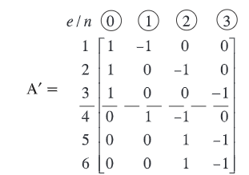
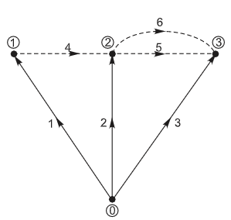
Element-node incidence matrix

Slide 5
Bus Incidence Matrix
The matrix obtained by deleting the column corresponding to the reference node in the element node incidence matrix A is called bus incidence matrix A.
Thus, the dimension of this matrix is ex (n - I)
and the rank will therefore be, n - 1 = b, where b is the number of branches in the graph.

Slide 6
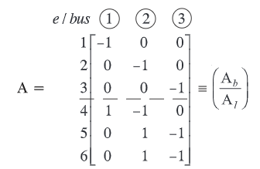

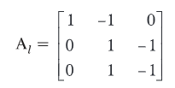
Bus Incidence Matrix

Slide 7
Branch - Path Incidence Matrix (K)
Branch path incidence matrix, as the name itself suggests, shows the incidence of branches to paths in a tree. The elements of this matrix are indicated by the operators as follows:
K^{pq} = I If the p^{th} branch is in the path from q^{th} bus to reference and oriented in the same direction.
K^{pq} = -1 If the p^{th} branch is in the path from q^{th} bus to reference and oriented in the opposite direction.
K^{pq} = 0 If the p^{th} branch is not in the path from the q^{th} bus to reference.

Slide 8
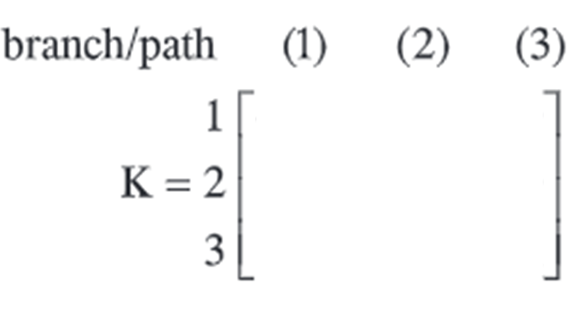
Branch - Path Incidence Matrix

Slide 9
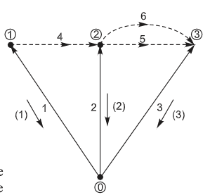
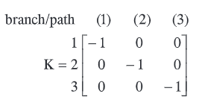
Branch - Path Incidence Matrix
While the branch path incidence matrix relates branches to paths. the sub matrix A_{b} gives the connectivity between branches and buses. Thus. the paths and buses can be
related by A_{b} K^{T} = U where U is a unit matrix.
Hence K^{T} = A_{b} ⁻¹

Slide 10
Basic Cut-Set Incidence Matrix
This matrix depicts the connectivity of elements to basic cut-sets of the connected graph. The elements of the matrix are indicated by the operator as follows:
B^{pq}=1 if the p^{th} element is incident to and oriented in the same direction as the q^{th} basic cut-set.
B^{pq}=-1 if the pth clement is incident to and oriented in the opposite direction as the qth basic cut-set.
B^{pq}=0 if the p^{th} element is not incident to the q^{th} basic cut-set.
The basic cut~set incidence matrix has the dimension e x b.

Slide 11
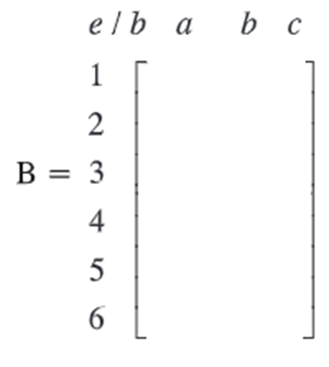
Basic Cut-Set Incidence Matrix

Slide 12
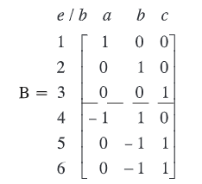
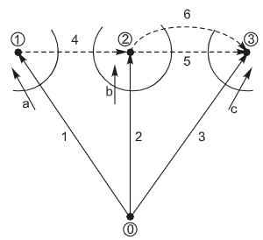
Basic Cut-Set Incidence Matrix

Slide 13
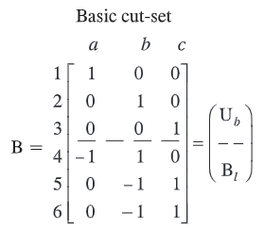
Basic Cut-Set Incidence Matrix
The identity matrix U_{b} shows the one-to-one correspondence between branches and basic cut-sets.
It may be recalled that the incidence of links to buses is shown by submatrix A_{I} and the incidence of branches to buses by A_{b}. There is a one-to-one correspondence between branches and basic cut-sets.
Since the incidence of Iinks to buses is given by B_{l}A_{b} = A_{I}
Therefore B_{I} = A_{I} A_{b} ^{-I}
However K^{T} = A_{b}^{- I}
Substituting this result in equation B_{I}=A_{I}K^{T}

Slide 14
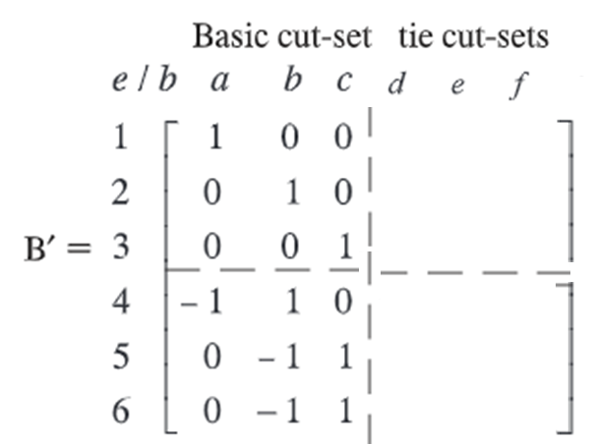
Augmented Cut-Set Incidence Matrix

Slide 15
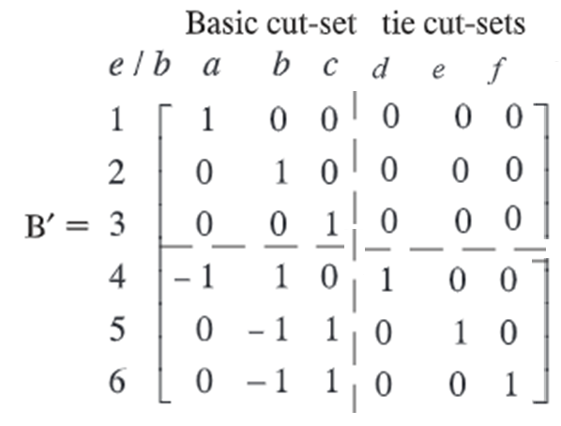
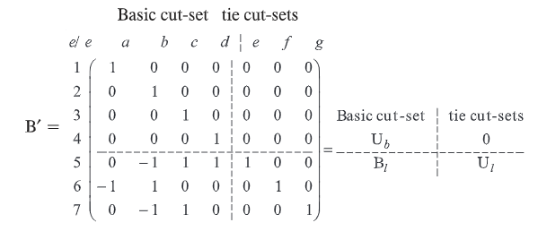
Augmented Cut-Set Incidence Matrix

Slide 16
Basic Loop Incidence Matrix
Basic Loop incidence matrix C shows the incidence of the elements of the connected graph to the basic loops. The incidence of the element is indicated by the operator as follows:
Y ^{pq}= I if the p^{th} element is incident to and oriented in the same direction as the q^{th} basic loop.
Y^{pq} = -1 if the p^{th} element is incident to and oriented in the opposite direction as the q^{th} basic loop.
Y^{pq} = 0 if the p^{th} element is not incident to the q^{th} loop.
The basic loop incidence matrix has the dimension e x I

Slide 17
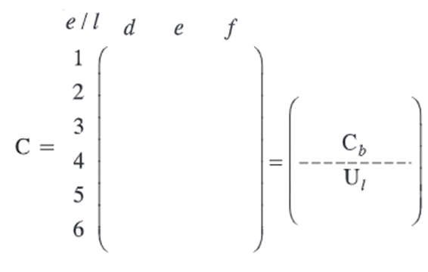
Basic Loop Incidence Matrix

Slide 18
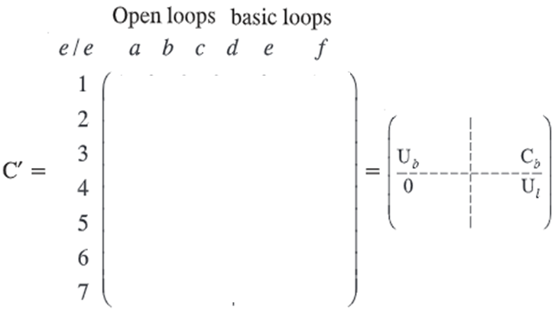
Augmented Loop Incidence Matrix

Slide 19
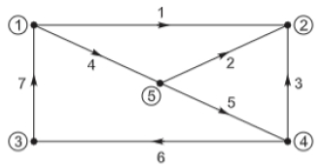
The graph shown in fig; select node 4 as reference node and Tree T{2,4,5,6}. Determine the incidence and augmented matrices, from these verify the followings 1.B_{L}=A_{L}K^{T} 2.C_{b}=-B_{L}^{T} 3.B_{L}=-A_{L}A_{b}⁻¹

Slide 20
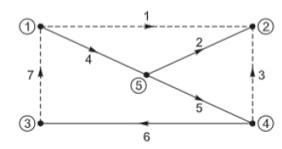
Tree Branches are given T{2,4,5,6}

Slide 21
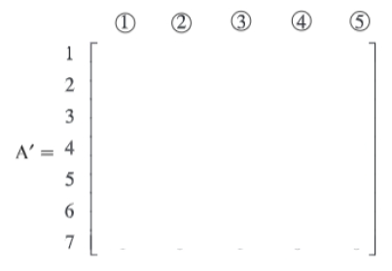
Element node incidence matrix (A’)

Slide 22
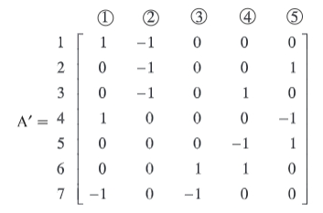
Element node incidence matrix (A’)

Slide 23
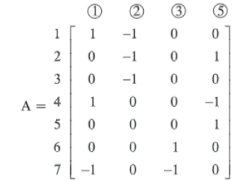
Bus incidence matrix (A)
Node 4 as reference , so delete the column corresponding node 4 in [A’]

Slide 24
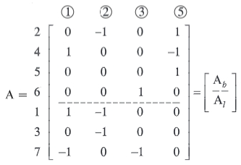
Bus incidence matrix (A)

Slide 25
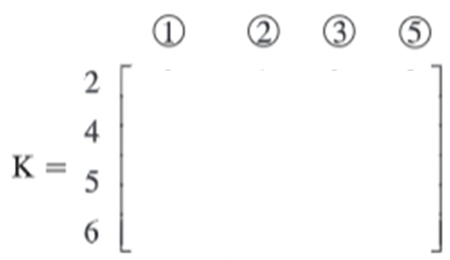
Branch path incidence matrices (K)

Slide 26
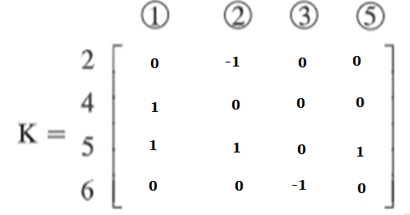
Branch path incidence matrices (K)

Slide 27
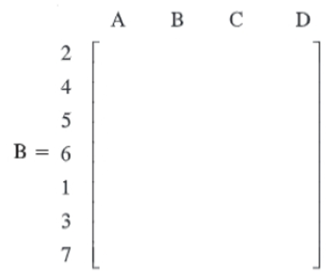
Basic cut set matrices B:

Slide 28
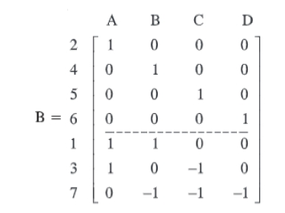
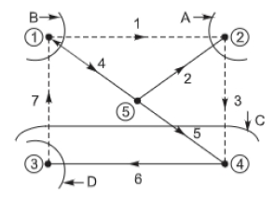
Basic cut set matrices B:

Slide 29
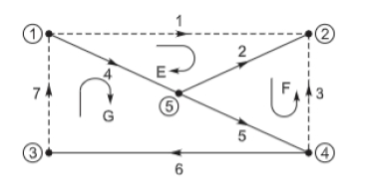
Basic loop incidence matrices

